Slide 1


Logic Gate Structure User Study
The Structure of Elements of Logic Circuits when Drawn on a Tablet PC versus those Drawn with a Pen on Paper
Sam Gordon, Raquel Robinson, Warren Liang, Christine Alvarado, Sarah Harris, and Tom Stahovich

Slide 2
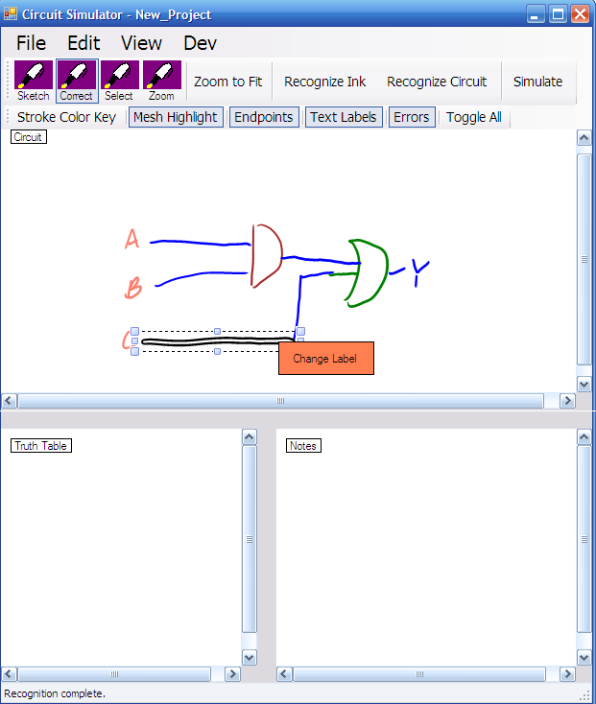
Background
Digital logic circuit recognition and modeling tool
Interface for Xilinx and ModelSim for creating and simulating circuit schematics

Slide 3
The Problem and a
Potential Solution
Problem:
Solution:
Looking for higher accuracy out of the Symbol Recognizer
Appropriate training data difficult to obtain
Train the Recognizer on data specific to the user
Does the user draw logic gates consistently across varying situations?

Slide 4
A User Study
Question 1:
Do users draw logic circuits consistently throughout situations of varying mental involvedness?
Question 2:
Do users draw differently on a Tablet PC than they do with a Pen on Paper?

Slide 5
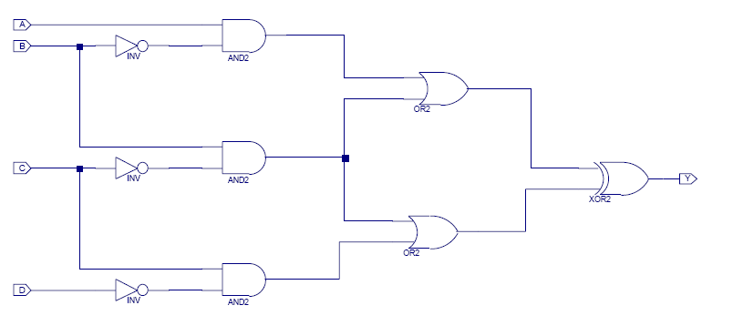
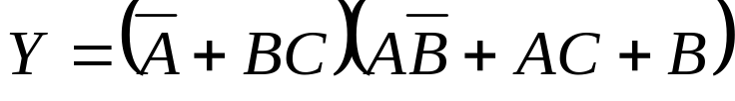
The Three Tasks
Task 1:
Draw single logic gates 10 Times
Task 2:
Copy a circuit from a Xilinx Schematic
AND, OR, XOR, NAND, NOR, NOT
Task 3:
Create a circuit from a
boolean logic equation

Slide 6
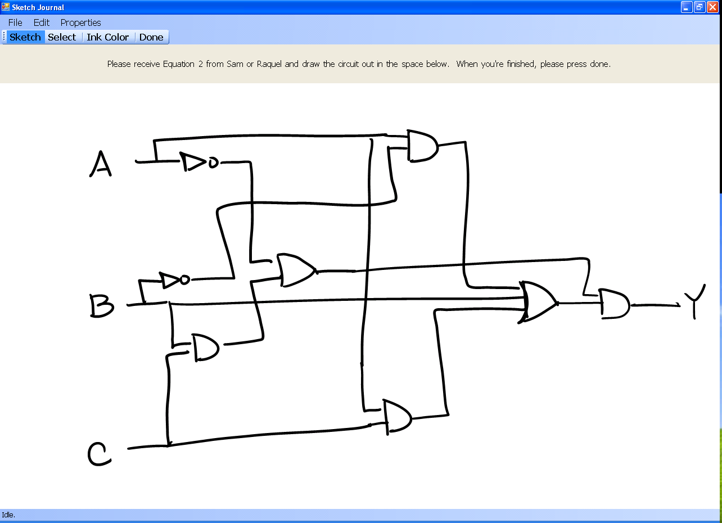
Ensure Statistical Relevance
Alternate Tablet PC and Pen and Paper
Rotate the order in which the three tasks are performed
Randomize the order the subsets of the three tasks are performed

Slide 7
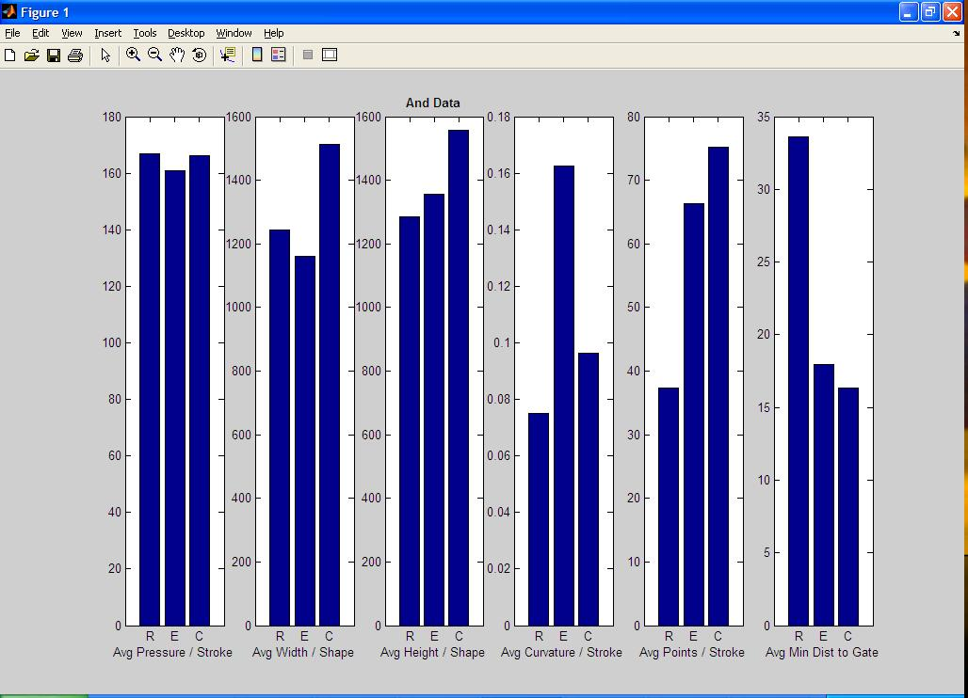
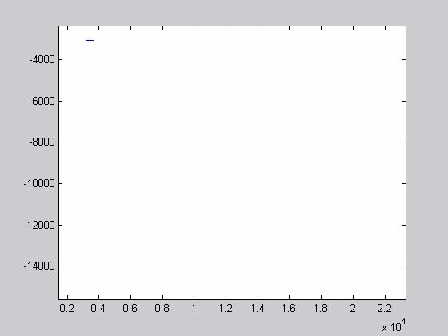
Analysis – Basic Visual
Bar Graphs
Matlab Movies

Slide 8
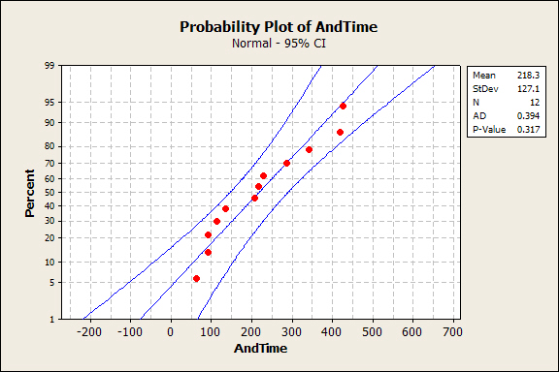
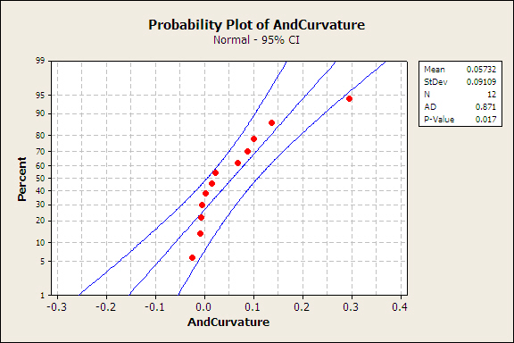
Analysis - Statistical
Test for Normality
If Normal:
One-Sample T-test
If Not Normal:
Sign Non-Parametric Test for Median
P-Value:
If P > 0.05 → Fail to reject null hypothesis
If P < 0.05 → Reject the null hypothesis and accept the alternate hypothesis

Slide 9
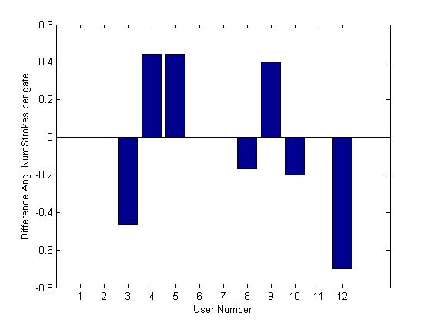
Results – Number of Strokes
Number of strokes per gate consistent across repeated-gate and synthesis tasks
Difference in Number of Strokes per Gate per User

Slide 10
Results - Time
Gate/Wire | Null Hyp. | Alt. Hyp. | P-Value | Result
AND | μ = 0 | μ > 0 | 0.000 | Reject H₀
OR | μ = 0 | μ > 0 | 0.0059 | Reject H₀
XOR | μ = 0 | μ > 0 | 0.0059 | Reject H₀
NAND | μ = 0 | μ > 0 | 0.002 | Reject H₀
NOR | μ = 0 | μ > 0 | 0.033 | Reject H₀
NOT | μ = 0 | μ > 0 | 0.050 | Reject H₀
ALL GATES | μ = 0 | μ > 0 | 0.0000 | Reject H₀

Slide 11
Results - Curvature
Gate/Wire | Null Hyp. | Alt. Hyp. | P-Value | Result
AND | μ = 0 | μ ≠ 0 | 0.3877 | Fail to Reject H₀
OR | μ = 0 | μ ≠ 0 | 0.2266 | Fail to Reject H₀
XOR | μ = 0 | μ ≠ 0 | 1.0000 | Fail to Reject H₀
NAND | μ = 0 | μ ≠ 0 | 0.007 | Reject H₀
NOR | μ = 0 | μ ≠ 0 | 1.0000 | Fail to Reject H₀
NOT | μ = 0 | μ ≠ 0 | 0.066 | Fail to Reject H₀
ALL GATES | μ = 0 | μ ≠ 0 | 0.5754 | Fail to Reject H₀

Slide 12
Results – Minimum Distance
Gate/Wire | Null Hyp. | Alt. Hyp. | P-Value | Result
AND | μ = 0 | μ ≠ 0 | 0.3877 | Fail to Reject H₀
OR | μ = 0 | μ ≠ 0 | 0.052 | Fail to Reject H₀
XOR | μ = 0 | μ ≠ 0 | 0.055 | Fail to Reject H₀
NAND | μ = 0 | μ ≠ 0 | 0.0039 | Reject H₀
NOR | μ = 0 | μ ≠ 0 | 0.0703 | Fail to Reject H₀
NOT | μ = 0 | μ ≠ 0 | 0.314 | Fail to Reject H₀
WIRE | μ = 0 | μ ≠ 0 | 0.006 | Reject H₀
ALL GATES | μ = 0 | μ ≠ 0 | 0.0005 | Reject H₀

Slide 13
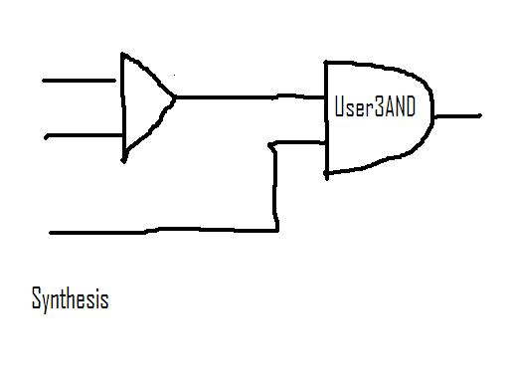
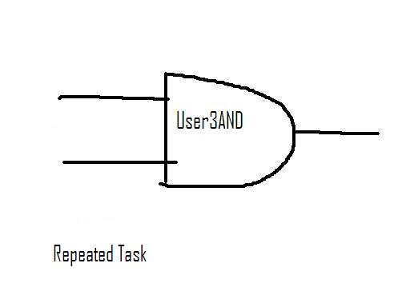
Conclusions
Curvature, minimum distance, and number of strokes consistently the same
Time consistently longer for synthesis task
Further research should include training and testing the Symbol Recognizer on the data collected

Slide 14
Future Work
Finish analyzing the data collected from the Tablet PC portion of the study
Analyze pen and paper portion of the study
Compare pen and paper results with Tablet PC results
Train and test Symbol Recognizer on individual user’s data

Slide 15
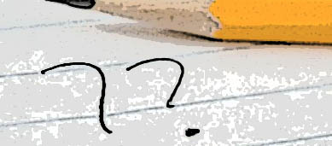
Questions?

Slide 16
Results – cont’d
Time taken to draw gates larger for synthesis task than for repeated task
Average Curvature for a gate the same for synthesis task and repeated task (except for NAND gates)
Minimum Distance from Gate to Wire the same for synthesis task and repeated task (except for NAND gates)

